Slide 1
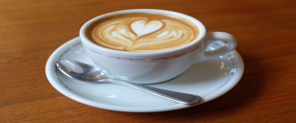
Lucky coffee shop
made by: Gräff Levente – homepage, css, debugging, hungarian presentation Geregely Marci – Coffee page Byrappa Arjuna – editing images, english presentation Abousena Adam – cakes, Trello

Slide 2
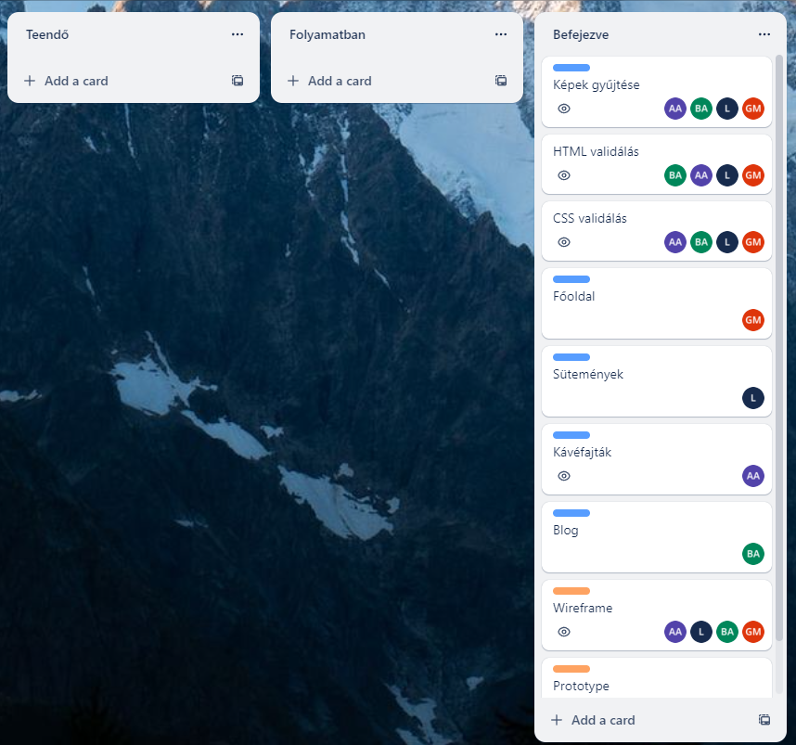
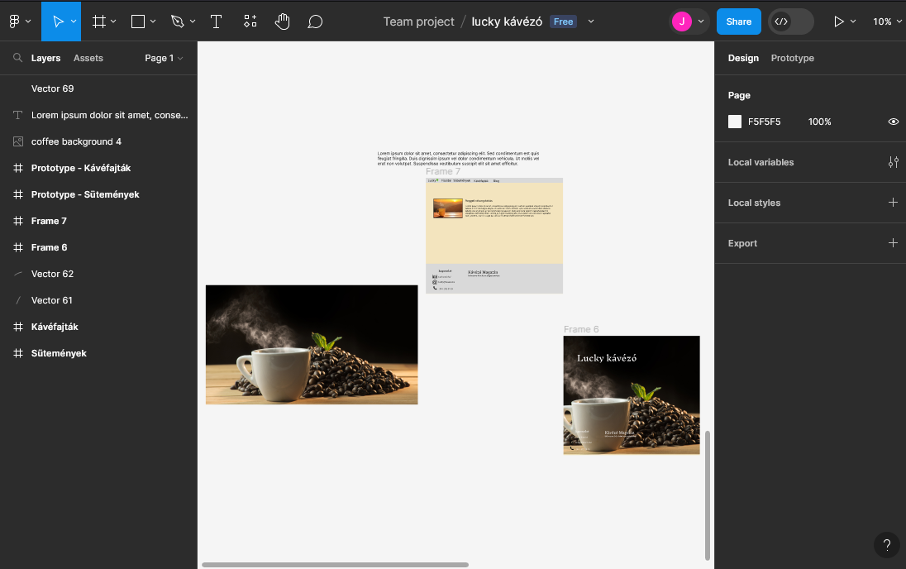
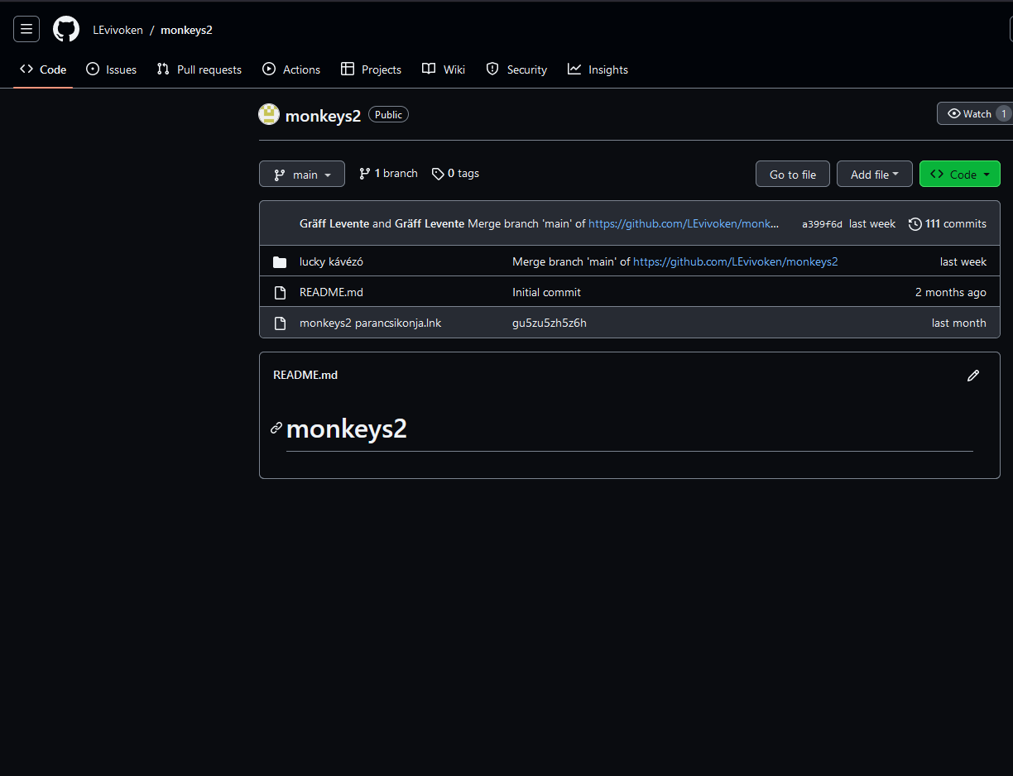
Tools we used
Trello
Github
Figma

Slide 3
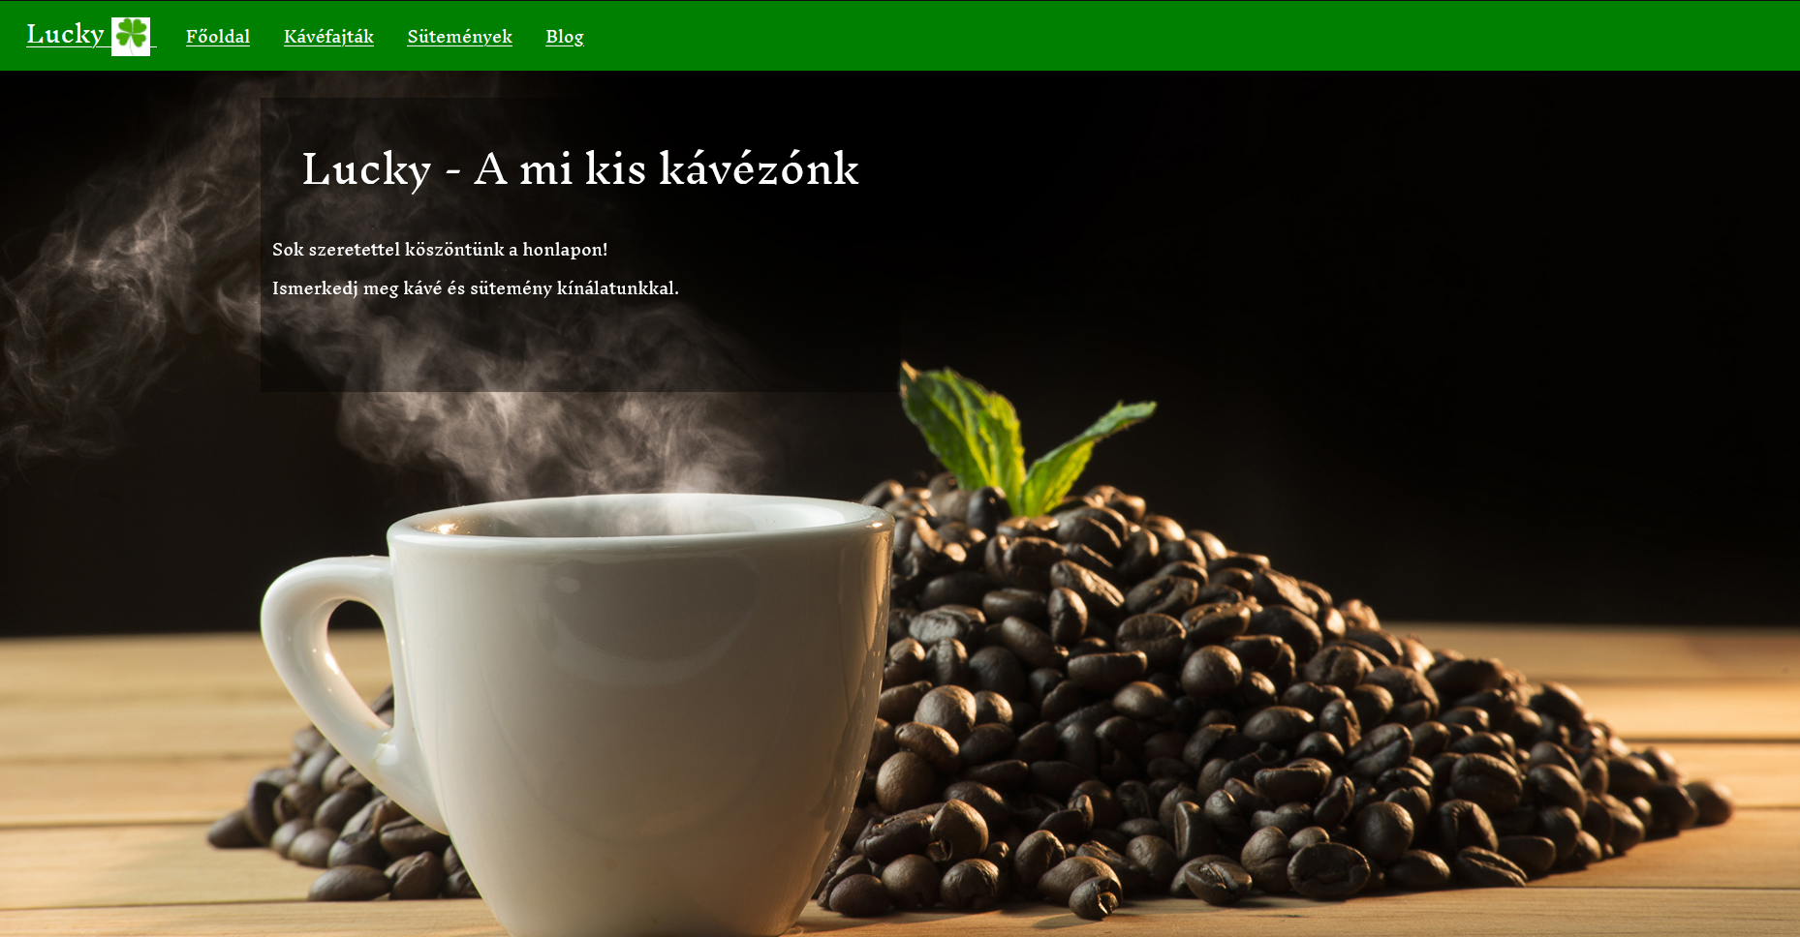
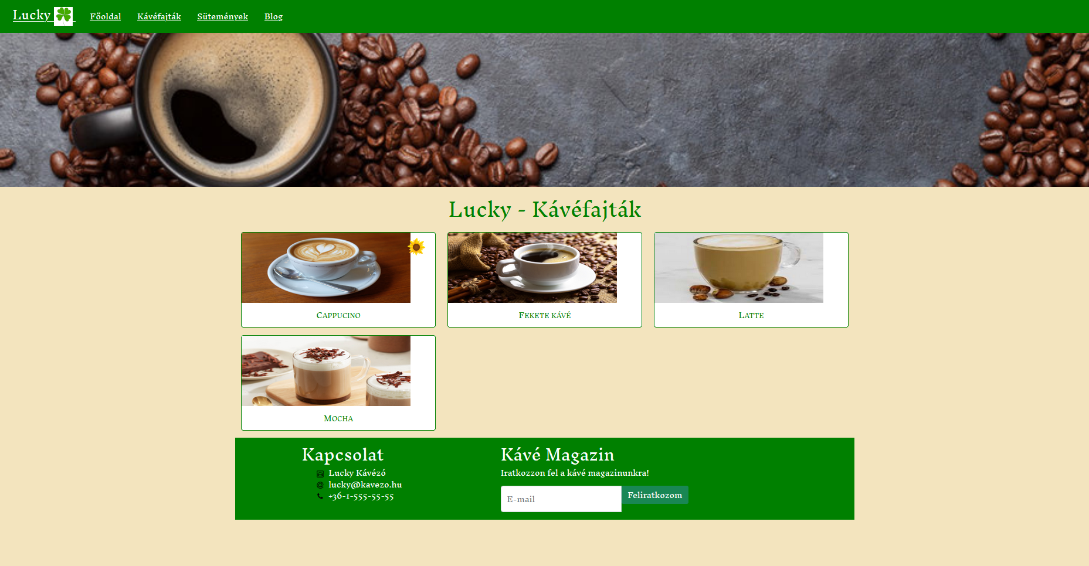
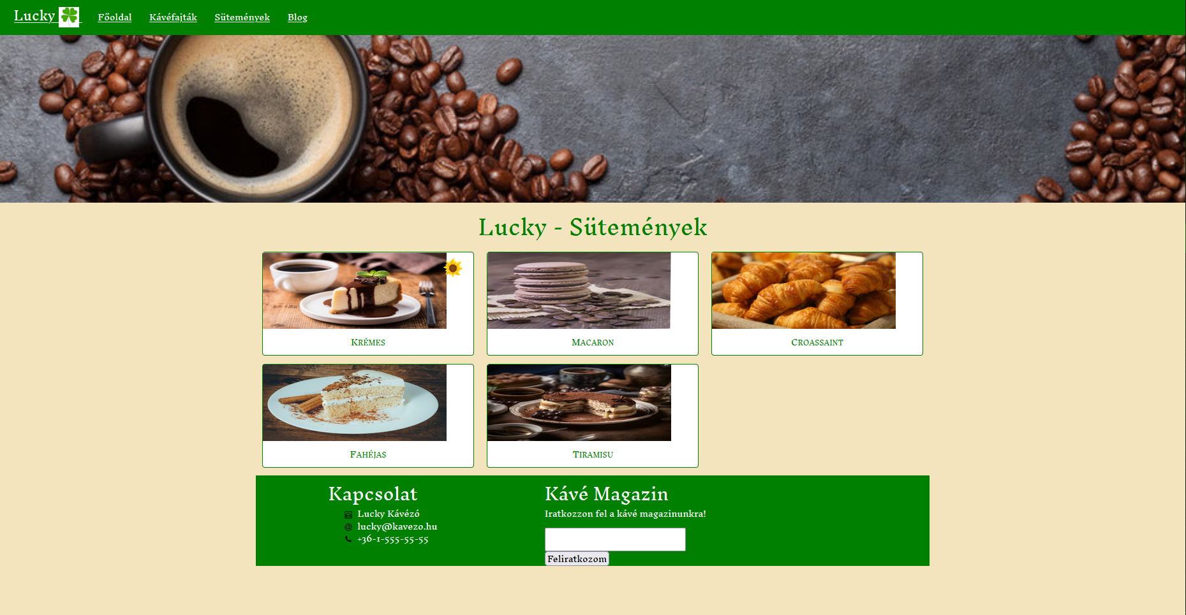
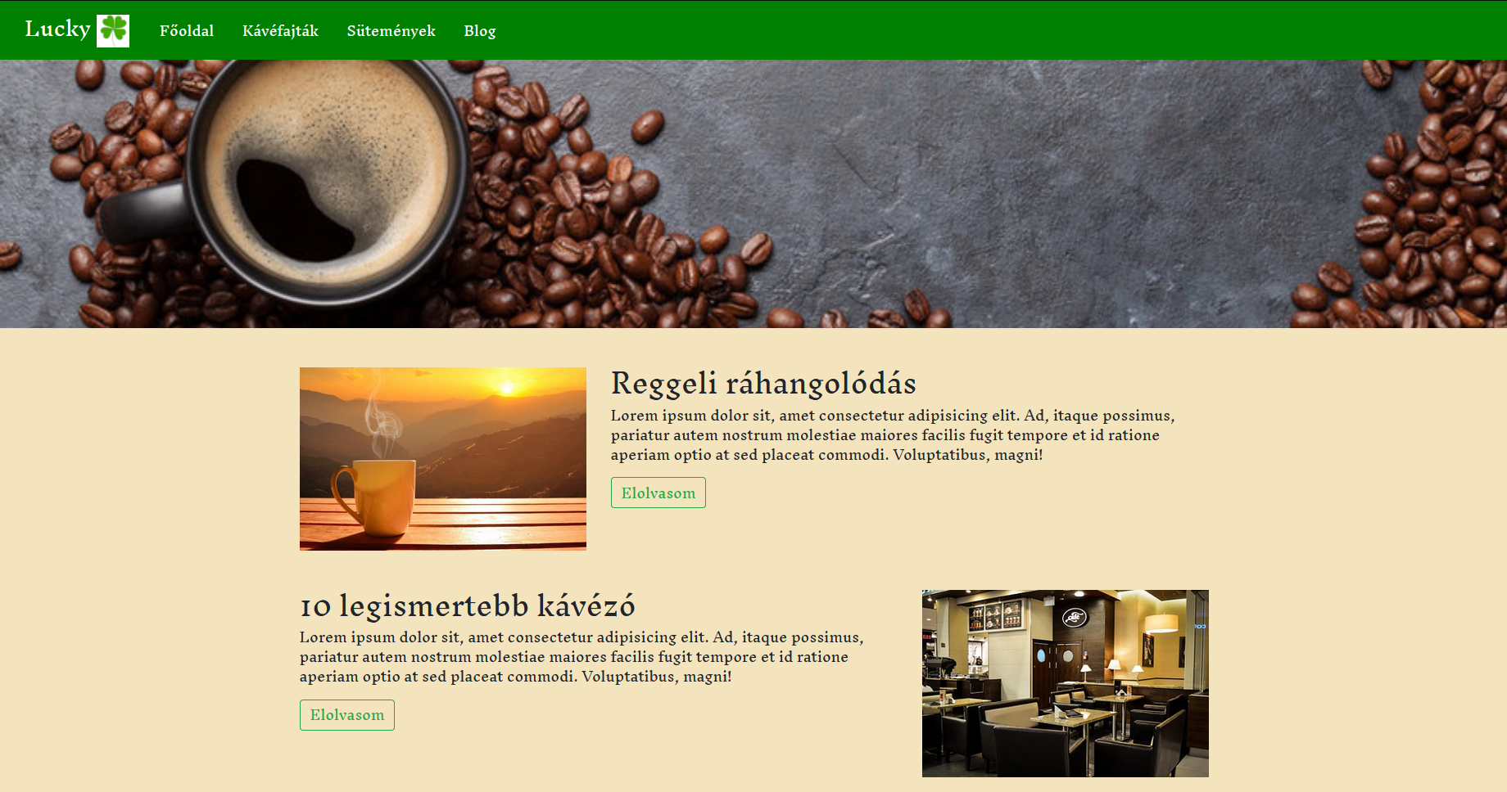

Slide 4
https://github.com/LEvivoken/monkeys2

Slide 5
Thank you for your attention

